Slide 1
Website Feedback

Slide 2
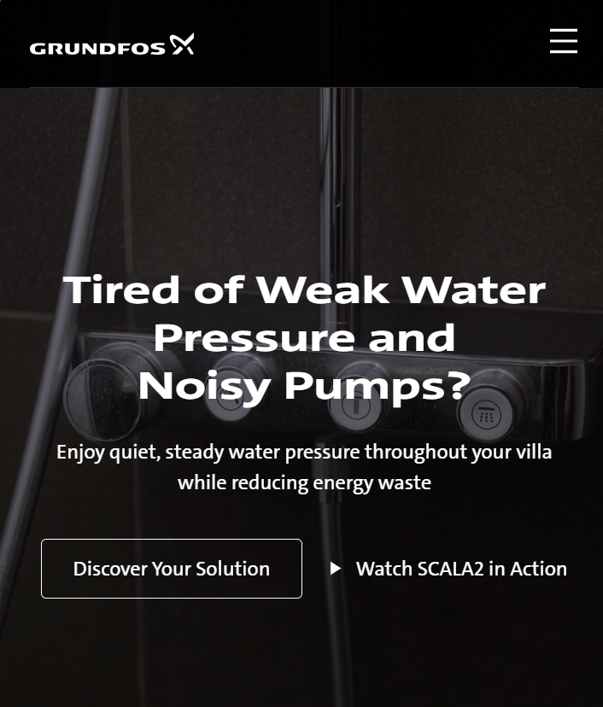
Please adjust based below copy
Headline: The Smart Water Pressure Solution for Modern UAE Villas
Subheading: Delivering constant pressure, whisper-quiet operation, and up to 40% energy savings—so every tap, shower, and moment at home feels more comfortable.
Can you please add audio to the video with the below script to be more engaging
Traditional pumps work at one speed.
SCALA2 thinks differently.
As your home's water demand changes, SCALA2 automatically adjusts its performance in real time.
The result?
Consistent water pressure.
Whisper-quiet operation.
And up to 40% lower energy consumption.
One intelligent system designed to make everyday life more comfortable.
SCALA2.
The smart water pressure solution for modern villas

Slide 3
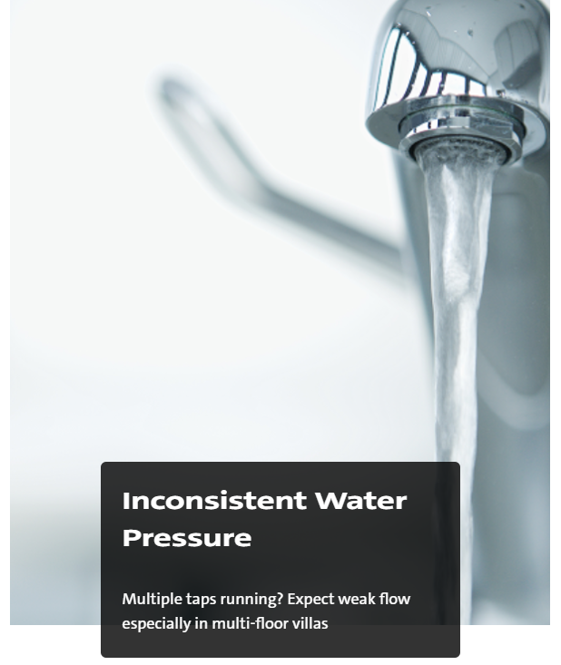
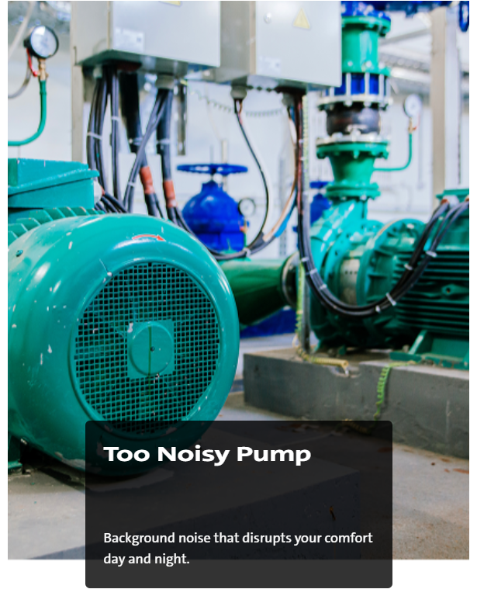
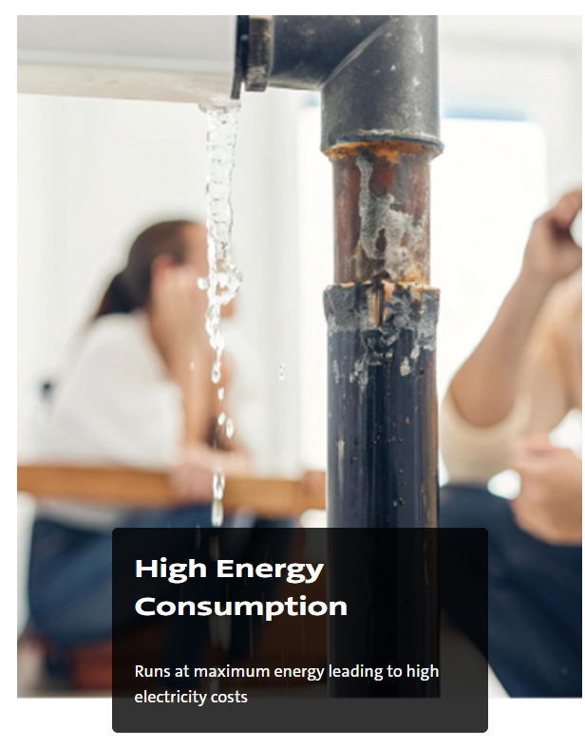
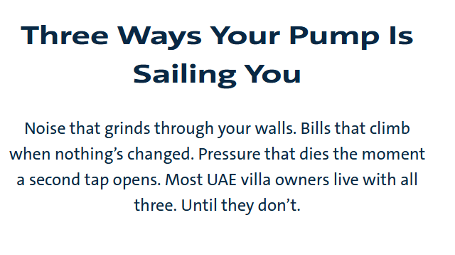
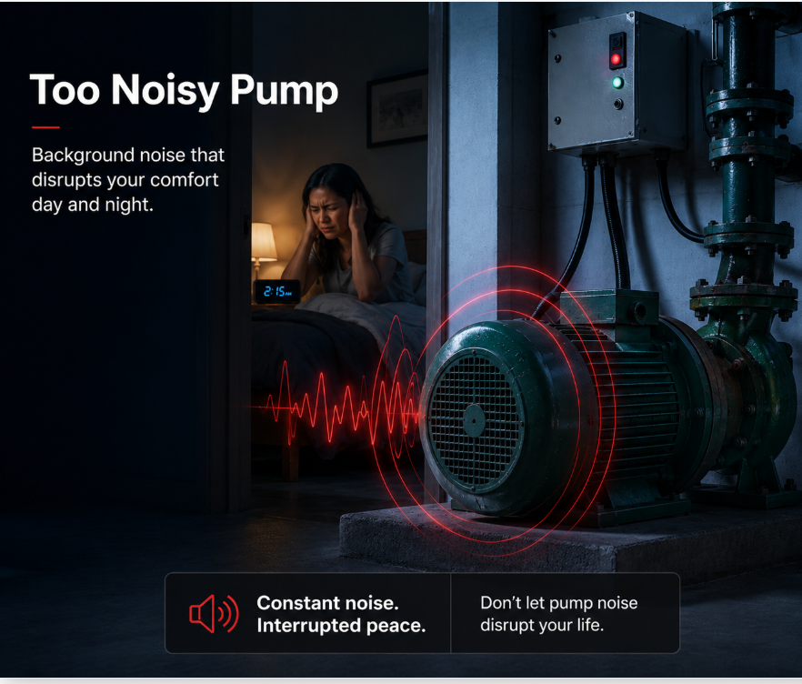
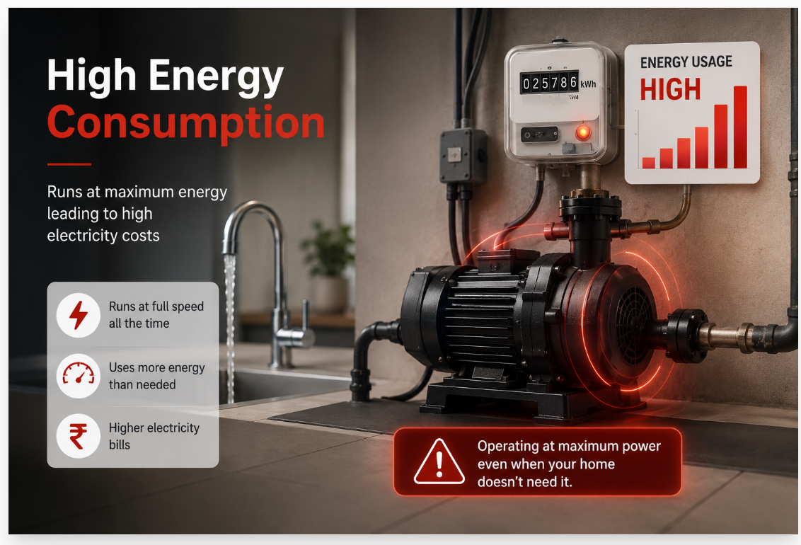
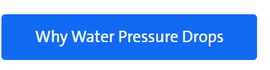
Current Visual: It shows industrial pump not domestic pump
Text: Noisy Pump
Use the below direction to change the visual
Please add the previous text where it was mentioned ‘’ Most homeowner replace their 3 reasons ect…’’
To bring more relevane
Headline:
Weak Water Pressure When You Need It Most
Supporting Text:
When multiple taps are used at the same time, water pressure can become inconsistent throughout your home.
Current Visual: A leaking, corroded pipe.
The image communicates: Water leakage - Maintenance issues
Please use the below image as direction for new visual
Please create Downloadable Brochure – based on the word document shared

Slide 4

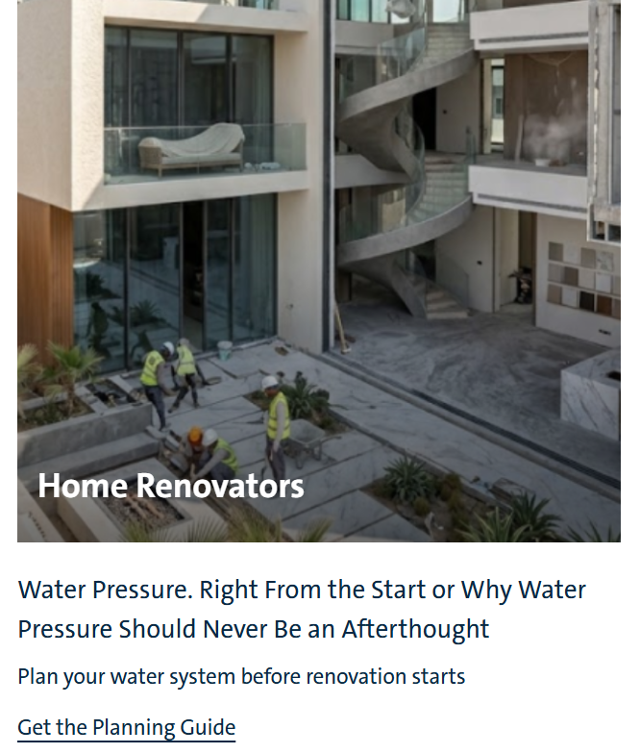
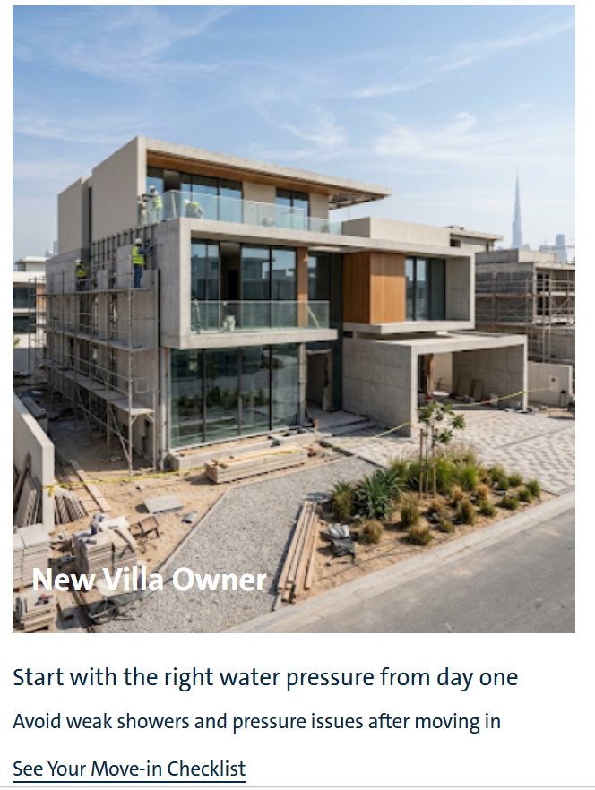
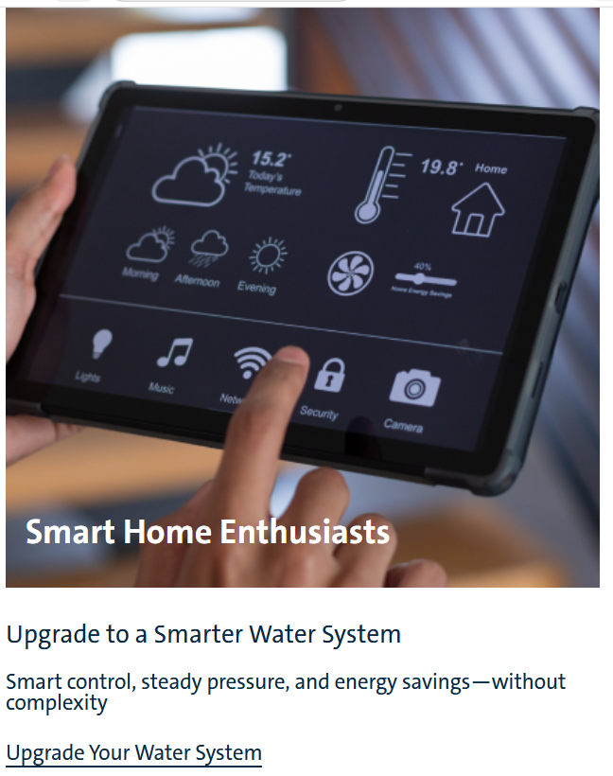
Better Home Comfort Starts Here
Moving into a new villa, planning a renovation, or upgrading your home? Get the guidance you need to make the right water pressure decisions.
In order to go live next week – please add brochure to be downloaded in the CTA in parallel we will work on the persona page development . Sharing a separate document to develop the 3 brochures.

Slide 5
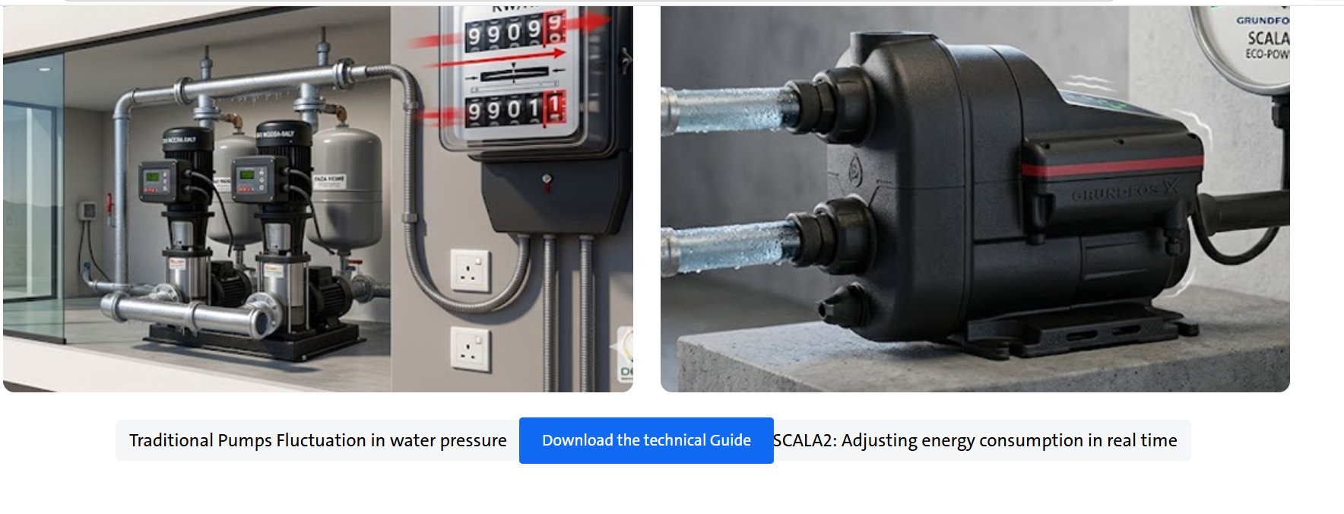
Adjust the CTA bottom as it is cutting the word
Also please adjust the copy to show save up to 40% energy saving

